Slide 1
MID SEMester project presentation
BY
Komal Reddy (20103005)
Jayanth Reddy (20103010)
Jnana Yasaswini (20103023)
Akhila Banoth (20103052)

Slide 2

Design and Development of English to Telugu Translation System based on Transformer with Deep Learning

Slide 3
Aim and Objectives
Architecture and flow diagram
Partial Results
Timeline
Conclusion and Future Work
Progress
CONTENTS

Slide 4
AIM AND OBJECTIVES

Slide 5
AIM
This project aims to create a proficient English to Telugu translation system using transformer architectures in deep learning. By bridging language gaps, it enhances communication and accessibility, offering an advanced tool for seamless translation between English and Telugu.

Slide 6
OBJECTIVES
Implement a transformer-based deep learning model for text translation.
Fine-tune the model to handle language-specific nuances and improve performance.
Implement appropriate evaluation metrics (e.g.,BLEU-score,accuracy)to quantitatively assess the translation quality.
Create an intuitive and user-friendly interface for users to input English text and receive the corresponding translated Telugu text.

Slide 7
ARCHITECTURE AND FLOW DIAGRAM

Slide 8
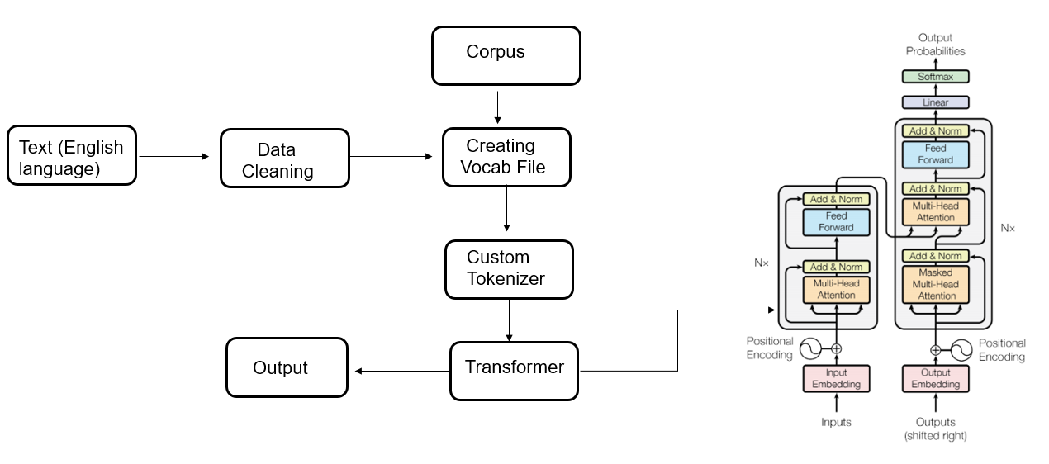
ARCHITECTURE AND FLOW DIAGRAM

Slide 9
PROGRESS

Slide 10
PROGRESS
Used Regex To Convert Contractions Into Natural Form
For example, won't to Will not
Created Custom Tokenizer Using Bert
Positional Encoding
Scaled Dot Product Attention
Multi Head Attention
Encoder and Decoder Layers
Feed Forward Network
Transformer Model
Training and Evaluation metrics

Slide 11
ATTENTION MECHANISM

Slide 12
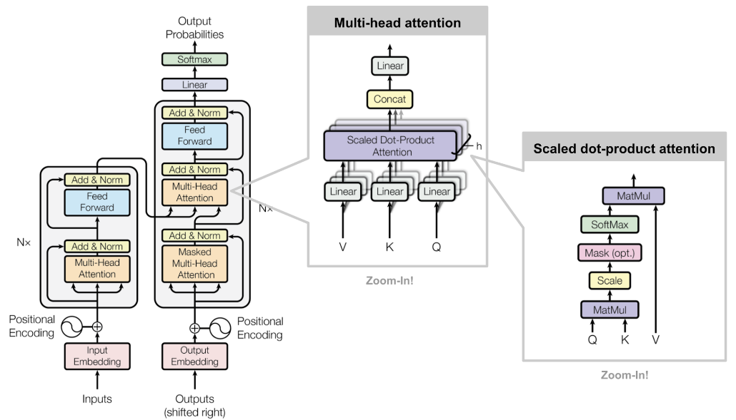
ATTENTION MECHANISM

Slide 13
SCALED DOT PRODUCT ATTENTION

Slide 14
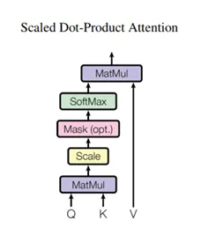

SCALED DOT PRODUCT ATTENTION
The attention function used by the transformer takes three inputs: Q (query), K (key), V (value). The equation used to calculate the attention weights is:
Query vector: Represented by a word vector in the sequence and defines the hidden state of the decoder.
Key vector: Represented by all the words in the sequence and defines the hidden state of the encoder.
Value vector: Represented by all the words in the sequence and defines the attention weights of the encoder hidden states.
The dot-product attention is scaled by a factor of square root of the depth. This is done because for large values of depth, the dot product grows large in magnitude pushing the softmax function where it has small gradients resulting in a very hard softmax.

Slide 15
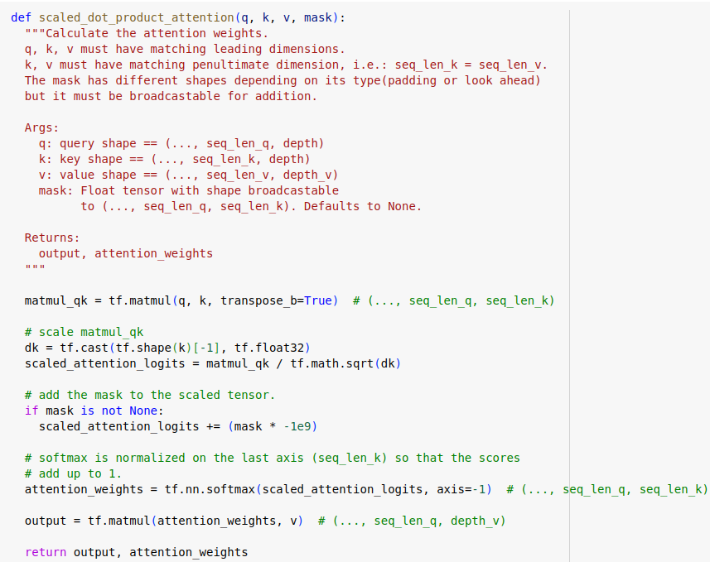
SCALED DOT PRODUCT ATTENTION

Slide 16
MULTI HEAD ATTENTION

Slide 17
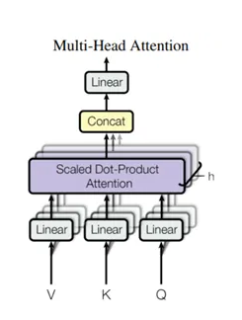
MULTI HEAD ATTENTION
Multi-head attention consists of four parts: Linear layers and split into heads, Scaled dot-product attention, Concatenation of heads, Final linear layer . Each multi-head attention block gets three inputs; Q (query), K (key), V (value). These are put through linear (Dense) layers and split up into multiple heads.
The scaled_dot_product_attention defined above is applied to each head (broadcasted for efficiency). An appropriate mask must be used in the attention step. The attention output for each head is then concatenated and put through a final Dense layer.
Instead of one single attention head, Q, K, and V are split into multiple heads because it allows the model to jointly attend to information from different representation subspaces at different positions. After the split each head has a reduced dimensionality, so the total computation cost is the same as a single head attention with full dimensionality.
The output represents the multiplication of the attention weights and the V (value) vector. This ensures that the words we want to focus on are kept as-is and the irrelevant words are flushed out.

Slide 18
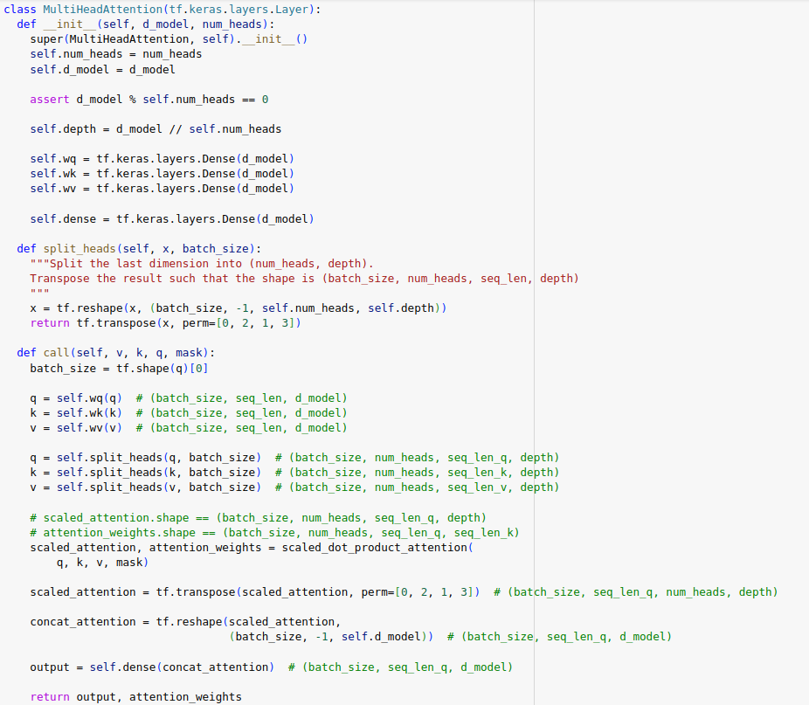
MULTI HEAD ATTENTION

Slide 19
MULTI HEAD ATTENTION

Slide 20
ENCODER

Slide 21
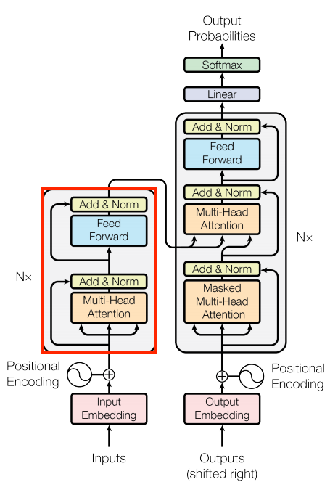
ENCODER LAYER
The encoder contains a stack of N encoder layers. Where each contains a GlobalSelfAttention and FeedForward layer
The encoder takes each word in the input sentence, process it to an intermediate representation and compares it with all the other words in the input sentence. The result of those comparisons is an attention score that evaluates the contribution of each word in the sentence to the key word. The attention scores are then used as weights for words’ representations that are fed the fully-connected network that generates a new representation for the key word. It does so for all the words in the sentence and transfers the new representation to the decoder that by this information can have all the dependencies that it needs to build the predictions.

Slide 22
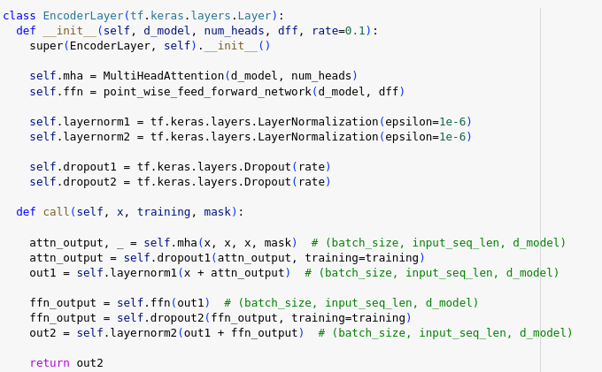
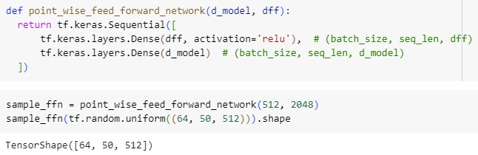
ENCODER LAYER

Slide 23
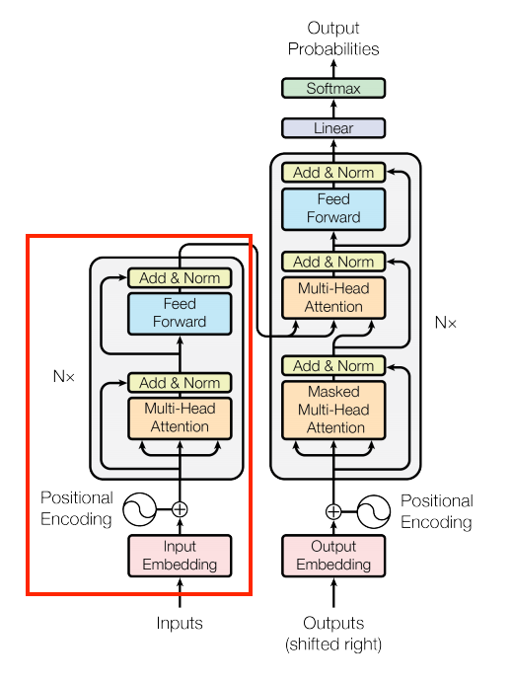
ENCODER
The encoder consists of:
A PositionalEmbedding layer at the input.
A stack of EncoderLayer layers.
The encoder receives the embedding vectors as a list of vectors, each of 512 (can be tuned as a hyper-parameter) size dimension. Both the encoder and the decoder add a positional encoding (that will be explained later) to their input. Both also use a bypass that is called a residual connection followed by an addition of the original input of the sub-layer and another normalization layer (which is also known as a batch normalization)

Slide 24
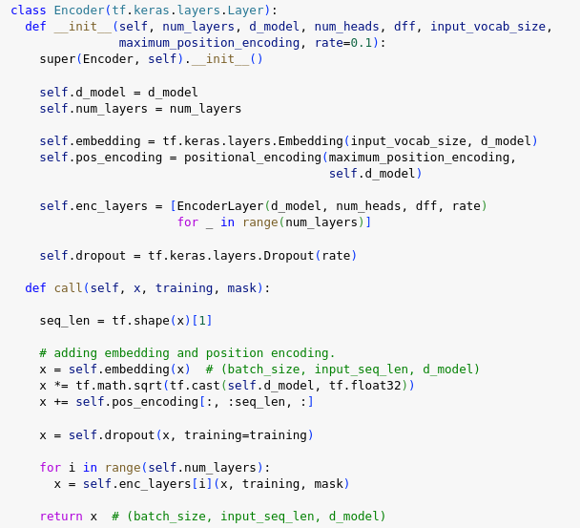
ENCODER

Slide 25
DECODER

Slide 26
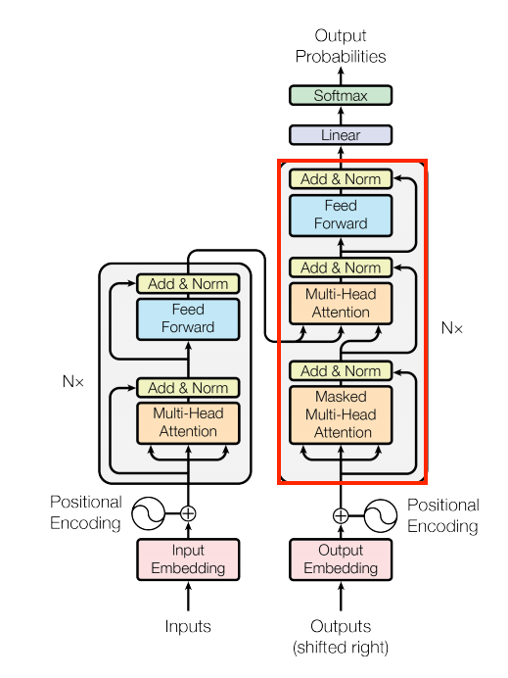
DECODER LAYER
The decoder's stack is slightly more complex, with each DecoderLayer containing a CausalSelfAttention, a CrossAttention, and a FeedForward layer
Similar to the Encoder, the Decoder consists of a PositionalEmbedding, and a stack of DecoderLayers
Unlike the encoder, the decoder uses an addition to the Multi-head attention that is called masking. This operation is intended to prevent exposing posterior information from the decoder. It means that in the training level the decoder doesn’t get access to tokens in the target sentence that will reveal the correct answer and will disrupt the learning procedure. It’s really important part in the decoder because if we will not use the masking the model will not learn anything and will just repeat the target sentence.

Slide 27
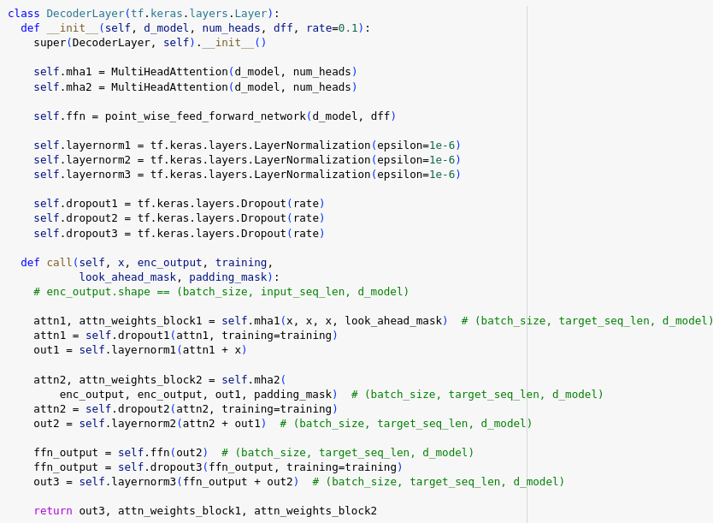
DECODER LAYER

Slide 28
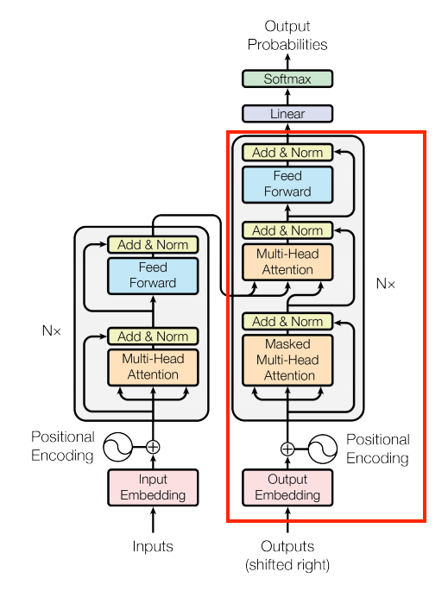
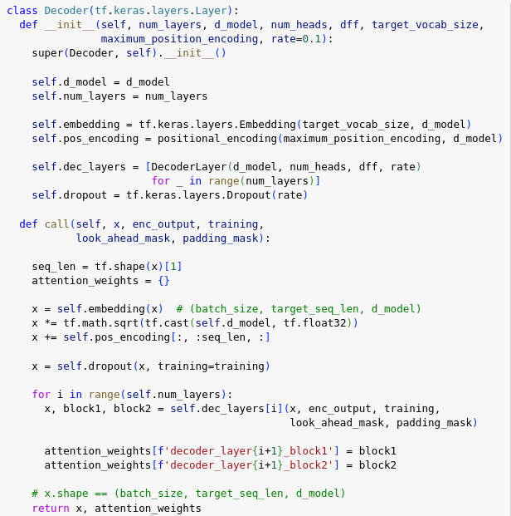
DECODER

Slide 29
TRANSFORMER

Slide 30
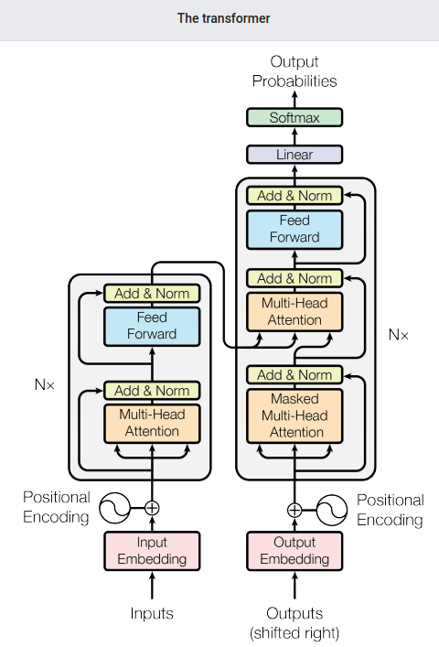
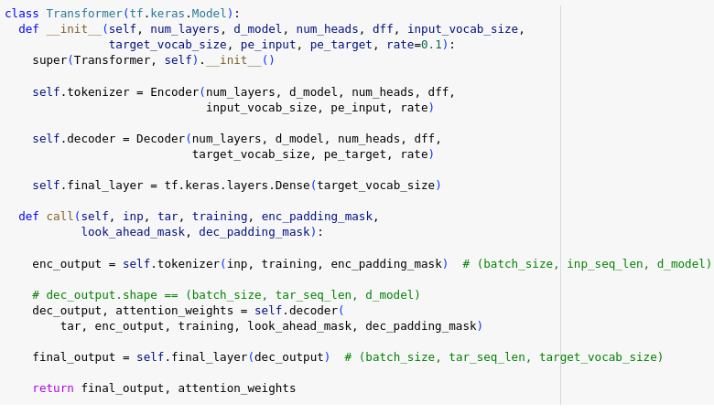
TRANSFORMER
We now have Encoder and Decoder. To complete the Transformer model, we need to put them together and add a final linear (Dense) layer which converts the resulting vector at each location into output token probabilities.
The output of the decoder is the input to this final linear layer.

Slide 31
PARTIAL RESULTS

Slide 32
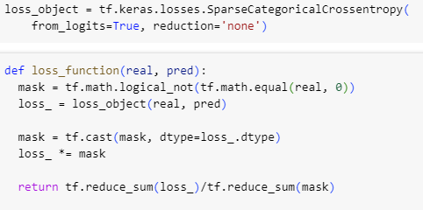
Evaluation Metrics
tf.keras.losses.SparseCategoricalCrossentropy: This is an implementation of the Sparse Categorical Crossentropy loss function
provided by TensorFlow's Keras API. It's commonly used for multi-class classification tasks where the target labels are integers.
loss_object=tf.keras.losses.SparseCategoricalCrossentropy(from_logits=True, reduction='none'): This line creates an instance of the SparseCategoricalCrossentropy loss function.
from_logits=True: Indicates that the input predictions are not normalized (i.e., they are raw logits) and need to be normalized (e.g., via a softmax activation) before being used in the loss calculation.
reduction='none': Specifies that no reduction should be applied to the individual losses. This means that the loss will be calculated separately for each sample in the batch, rather than being aggregated across the batch.

Slide 33
Evaluation Metrics
mask = tf.math.logical_not(tf.math.equal(real, 0)): This line creates a mask tensor where elements of real that are equal to 0 are marked as False and all other elements are marked as True. This is typically used to mask out padding elements in sequence data.
loss_ = loss_object(real, pred): This line calculates the loss using the SparseCategoricalCrossentropy loss function created earlier. Since reduction='none', this will return a tensor containing the individual losses
for each sample in the batch.
mask = tf.cast(mask, dtype=loss_.dtype): This line casts the mask tensor to the same data type as the computed loss tensor.
loss_ *= mask: This line applies the mask to the computed loss tensor. This effectively zeros out the loss for padding elements, as they are marked as False in the mask. And at last we calculate mean losses

Slide 34
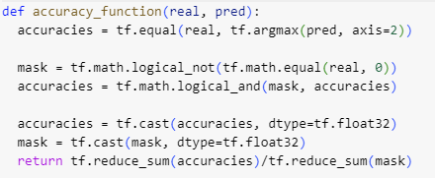
Evaluation Metrics
tf.equal(real, tf.argmax(pred, axis=2)) returns a tensor where each element is True
if the corresponding element in
real matches the index of the maximum value in the corresponding position of pred, and False otherwise
mask =tf.math.logical_not(tf.math.equal(real, 0)): This creates a boolean mask where True indicates positions where the real values are not equal to 0 (non-padding positions).
tf.math.logical_and(mask, accuracies): Here, the mask is further refined by performing a logical AND operation with the previously computed accuracies. This ensures that only positions where the real values are not padding and the predictions are correct contribute to the accuracy calculation.
accuracies = tf.cast(accuracies, dtype=tf.float32): Converts the boolean tensor of accuracies to float32 data type. This conversion is necessary for subsequent calculations.
mask = tf.cast(mask, dtype=tf.float32): Similarly, converts the boolean mask to float32 data type. This will be used for normalization in the accuracy calculation.
Finally mean accuracy is calculated

Slide 35
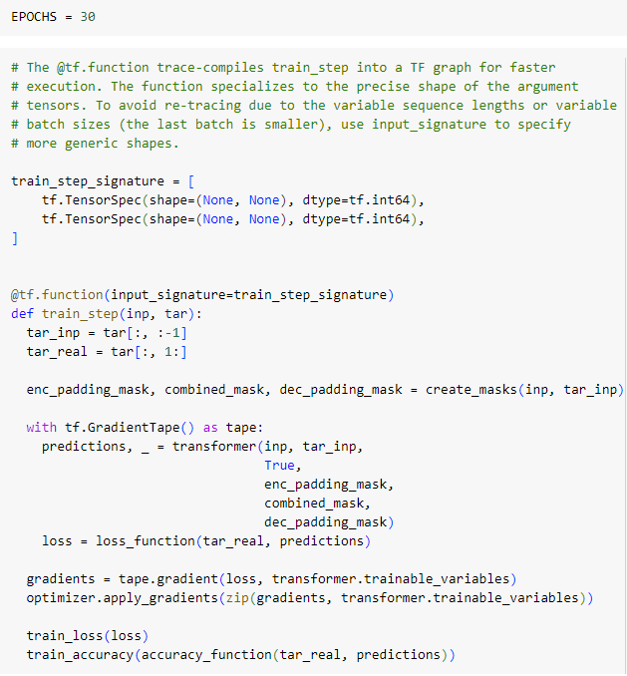
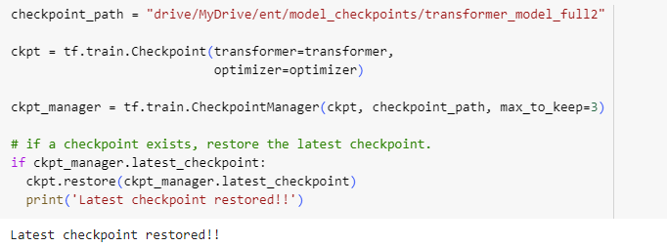
Training the model
This is the drive mount path where we store our training steps result
On the right training step is defined where we take inputs target_input and target_real and then call transformer model on it . After model is trained, The loss is calculated using the loss_function, which likely computes the Sparse Categorical Crossentropy loss.
Gradients of the loss with respect to the trainable variables of the transformer model are computed using automatic differentiation (tf.GradientTape).
The optimizer is then applied to update the model's parameters based on the computed gradients.

Slide 36
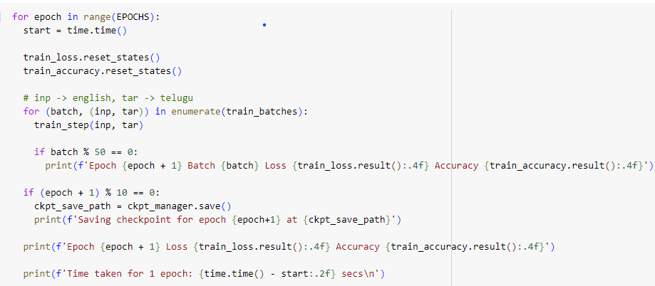
Training the model
This is the training step where we have EPOCHS set to 30 and call train_step function we defined before on each batch

Slide 37
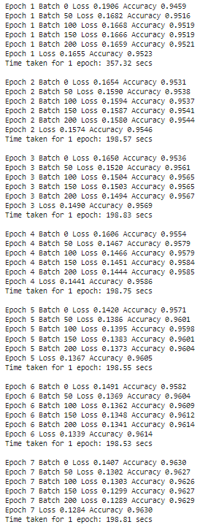
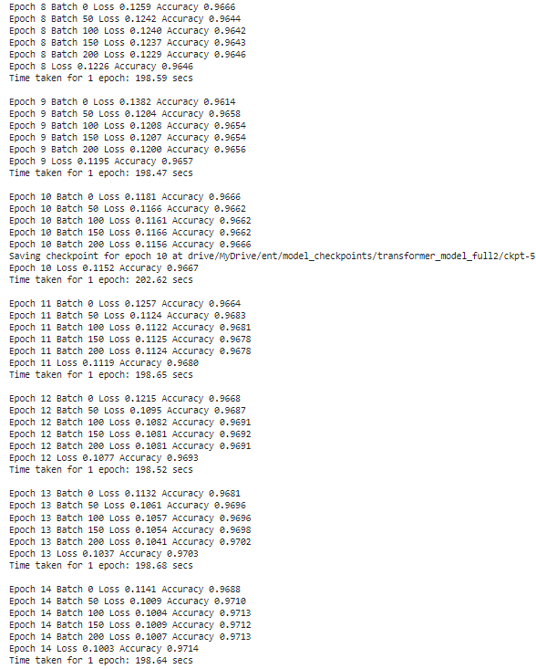
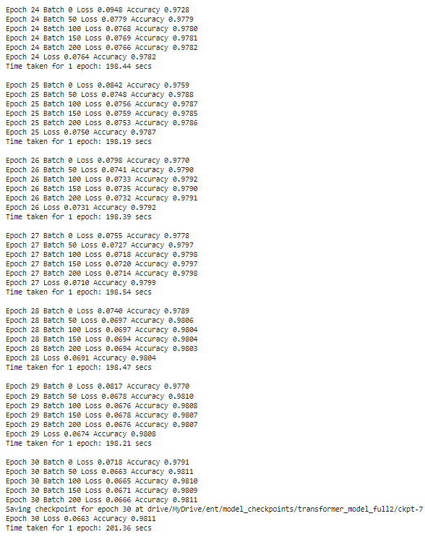
Training the model
These are the epochs during training
Total of 30 epochs
The last checkpoint is number 7 with loss of 0.0663 and accuracy of 0.9811 (98%)

Slide 38
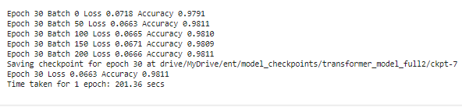
Training the model
Each epoch has training sets in batches with their respective loss and accuracy , these trained batch is stored in google drive with given mount path , and time taken for each epoch is also displayed with cumulative loss and accuracy
We achieved an accuracy of 98% on trained sets

Slide 39
TIMELINE

Slide 40
TIMELINE
Oct. 2023
Dataset Preparation
Data Preprocessing
Nov. 2023
Creating Vocab File
Custom tokenizer
Dec. 2023
Building Attention Mechanism
Jan. 2024
Encoder Layer
Feb. 2024
Decoder Layer
Mar. 2024
Transformer and training
Testing
Apr. 2024
Deployment
May. 2024

Slide 41
CONCLUSION AND FUTURE WORK

Slide 42
CONCLUSION AND FUTURE WORK
In conclusion, our team's next crucial step involves training the model and evaluating its performance using the BLEU score metric. This evaluation will provide valuable insights into the accuracy and efficacy of our translation system. Upon achieving satisfactory results, we will proceed with the deployment phase, ensuring widespread accessibility and usability of our advanced English to Telugu translation tool.

Slide 43
WE Komal Reddy (20103005) Jayanth Reddy (20103010) Jnana Yasaswini (20103023) Akhila Banoth (20103052) AS A TEAM THANK YOU

